Slide 1


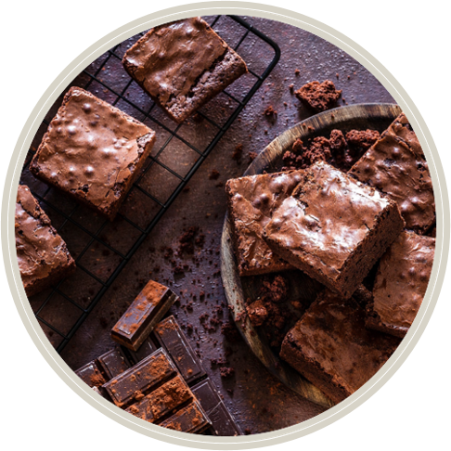
Welcome to MealMate
Smile Wide, Eat Right!

Slide 2
Bokkela Sarathchandra
Team Members
Illa Sunil Sri Vamsi
HM0012742
HM0012729
Nistala Sravya
Annepu Punyavardhan Raj
HM0012738
HM0012727

Slide 3
Pain points
Food Variety and Repetition
Difficulty in Choosing Meal Plans
Meal Planning Complexity

Slide 4
Solutions
Regularly updated menus with diverse meal options ensure that users experience new dishes, minimizing food fatigue and keeping meals interesting.
MealMate offers a variety of subscription options tailored to different dietary needs.
MealMate includes an intuitive app feature that simplifies meal planning for users, allowing them to easily manage their subscriptions and meal preferences.
MealMate has implemented a reliable delivery system that allows users to choose delivery times and track their orders in real time

Slide 5

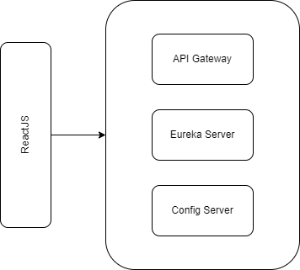

Architecture
MealMate Admin
MealMate User

Slide 6
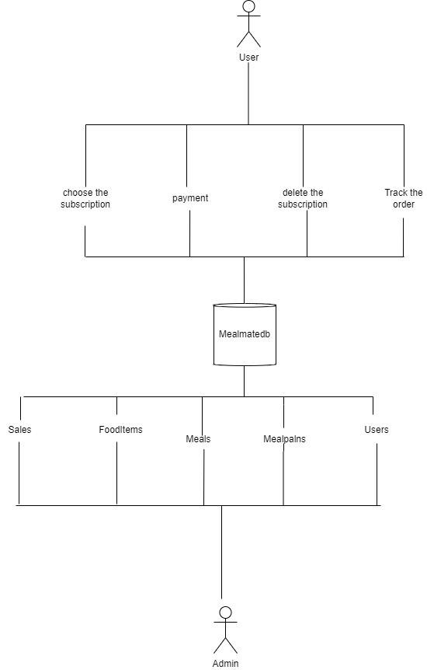
Data Flow

Slide 7

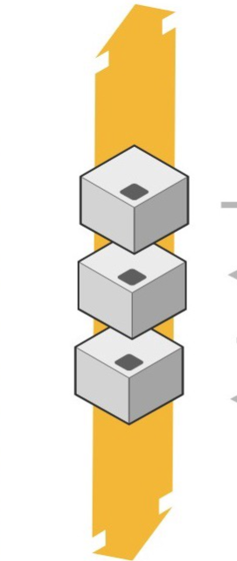
Eureka Server
Register
LookUp / Query
Connect
Microservices
(Eureka Client)

Slide 8
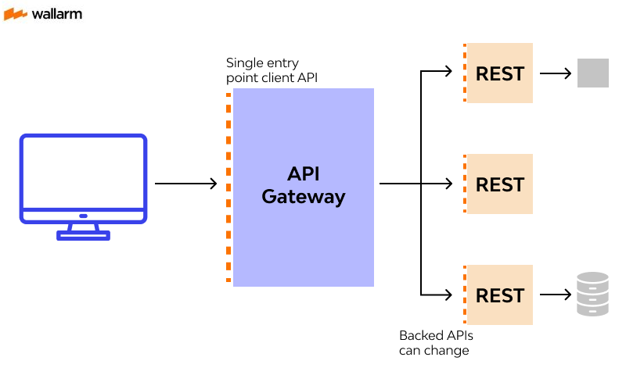
API GateWay

Slide 9

Config-server
Microservices
GIT
REPOSITORY
MealMateAdmin
MealMateUser​
FILE STORE

Slide 10
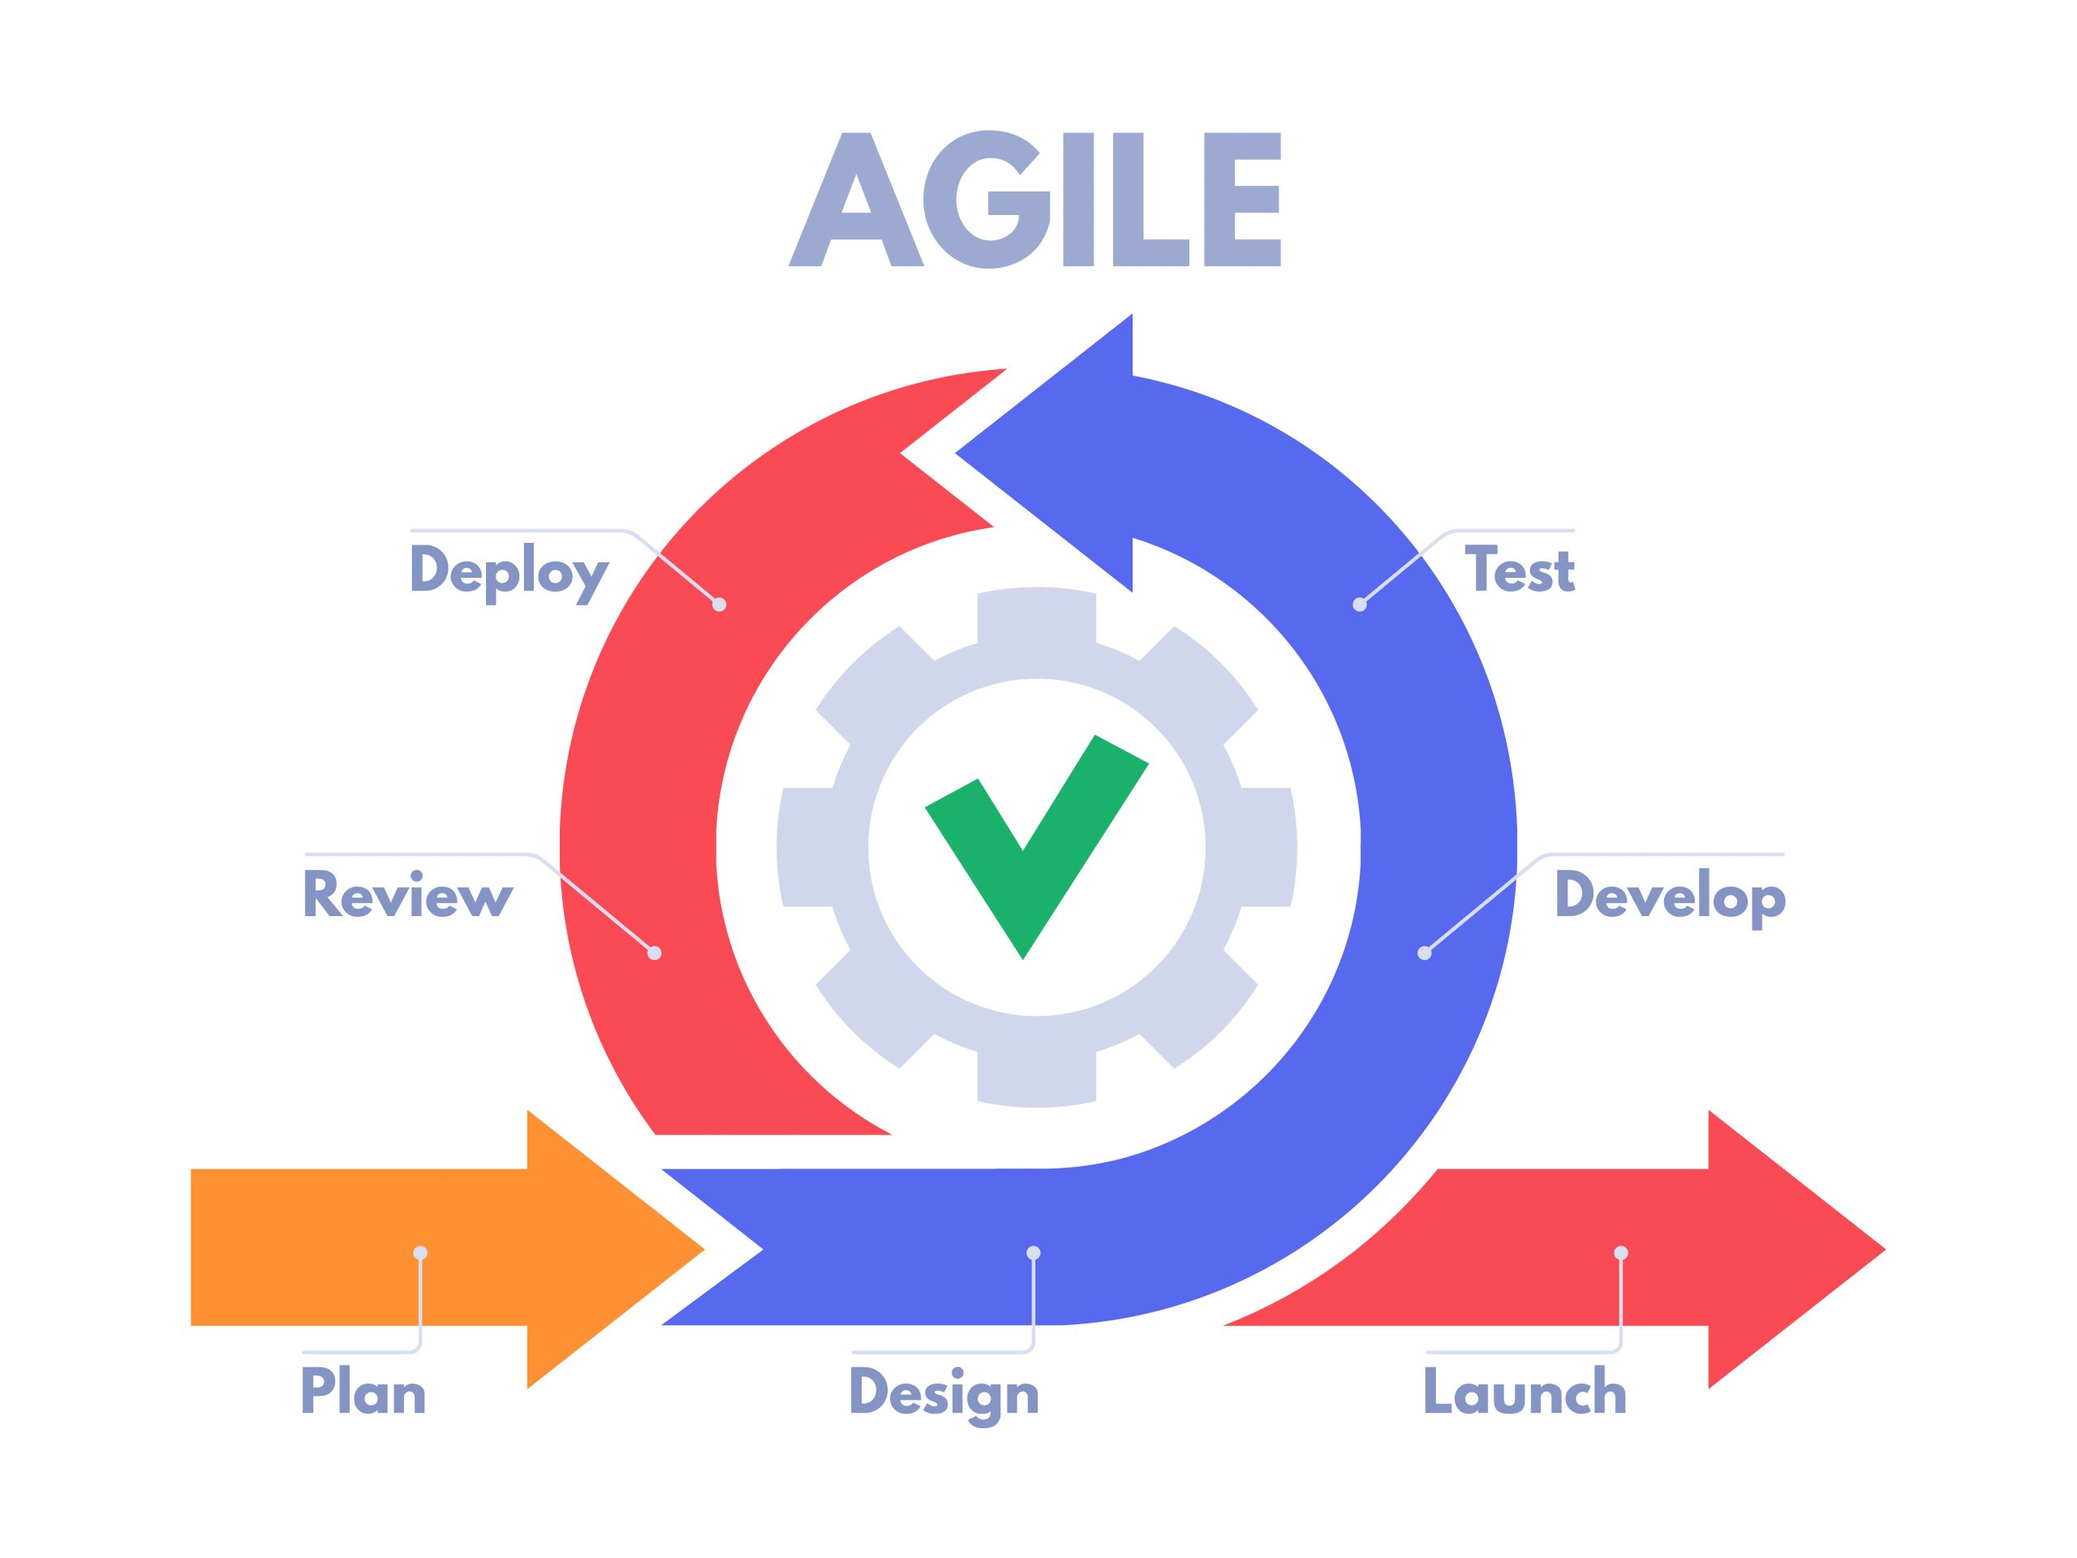
Agile Methodology

Slide 11
Project Backlogs
We will integrate a customer service chatbot for user support.
We will implement registration via Google and Facebook.
We will provide a BMI calculator feature for users.
We will offer discount coupons for special offers.

Slide 12
Detailed Demo of MealMate

Slide 13
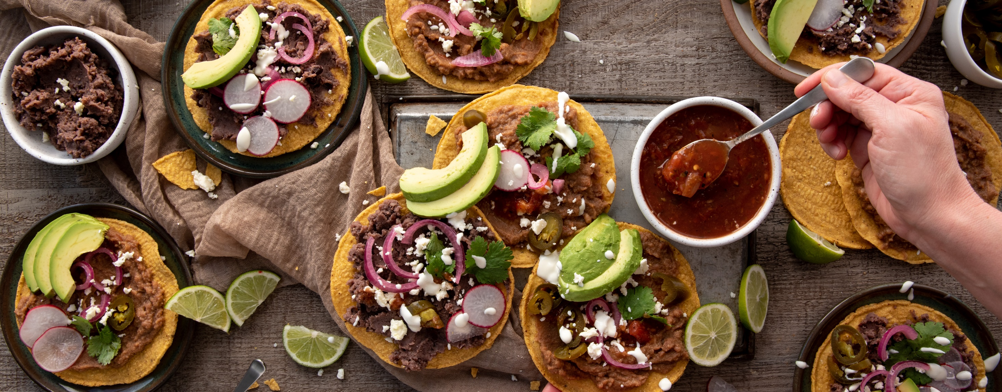
Thank You
Smile Wide, Eat Right!

